Slide 1
The Investment Plan
for Europe
European Fund for Strategic Investments (EFSI) workshop
Brussels, 1st October 2015

Slide 2
EU economic context
Despite challenging global economic environment, the recovery in the EU continued at a moderate pace (GDP forecast 2015=1,8%);
Most former vulnerable economies are growing faster than expected;
Economic growth in the EU is benefiting from the strength of economic tailwinds (low oil prices, a still low external value of the Euro, ECB's QE, broadly neutral fiscal stance);
Labour markets are gradually improving but unemployment remains high;
HICP inflation to recover later this year and next.

Slide 3
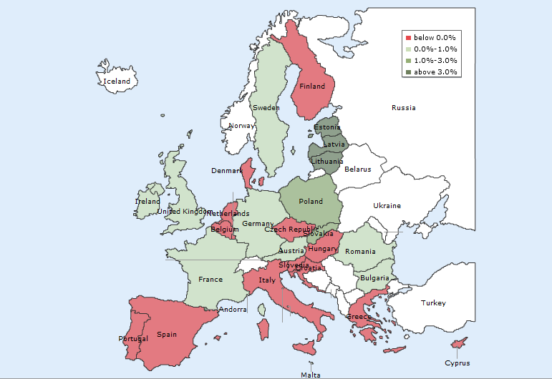
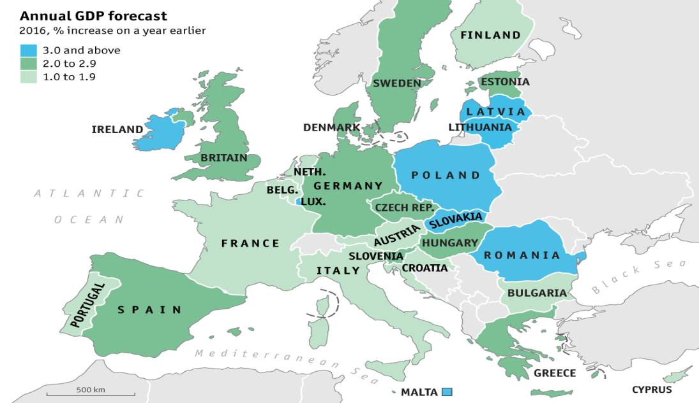
The economic situation is improving and the recovery is taking hold
European growth map 2012
European growth map 2016 (forecast)

Slide 4
EU Investment Plan: rationale
EU investment & competitiveness gap
EU Investment Plan
EU/MS policy action + EU budget + EIB capacity to mobilise private sector funds towards strategic investments.
High liquidity in the market
Public budget constraints
Financial and non-financial barriers to investment

Slide 5
The €315bn Investment Plan has the potential to bring investments back in line with historical norms
Real gross fixed capital formation – Baseline trend vs. historical norm vs. investment plan EU-28, in 2013 prices, € bn
Historical trend / Baseline forecasts
Investment plan
GFCF historical norm, assuming an investment/GDP ratio of 21-22%
3,039
3,021
2,940
2,869
2,864
2,714
2,748
2,640
2,717
2,657
2,659
2,647
2,678
2,543
2,606
2,527
2,567
2,528
2,416
forecasts
Source: DG ECFIN, AMECO database

Slide 6
EU Investment Plan: 3 pillars
1. MOBILISING FINANCE FOR INVESTMENT
2. MAKING FINANCE REACH THE REAL ECONOMY
Boost investment in strategic projects and access to finance via the European Fund for Strategic Investments (EFSI) within EIB/EIF
Cooperation with National Promotional Banks and the EIB
European Investment Project Portal
European Investment Advisory Hub: technical assistance
3. IMPROVED INVESTMENT ENVIRONMENT
Predictability and quality of regulation
Removing non-financial, regulatory barriers in key sectors within EU Single Market
Structural reforms at national level

Slide 7
3. Improved investment environment
Better and more predictable regulation at all levels
Making most of the Single Market
Energy Union
Digital Single Market
Capital Markets Union: action plan
Services Market
Structural reforms in the Member States
Openness to international trade and investment

Slide 8
2. Making finance reach the real economy
Transparency on the investments in Europe
European Investment Project Portal – any public/private entity
Matching investment opportunities proposed by project sponsors with investors' interest
Strengthening advisory services
European Investment Advisory Hub (EIAH) – EC/EIB
Technical assistance
Pooling resources & expertise including from MS

Slide 9
1. European Fund for Strategic Investments
EFSI risk-bearing capacity
€ 21bn
EU budget
guarantee
€ 16bn
€ 5bn
3x
EFSI
EIB / EIF financing
∼ € 61 bn
Infrastructure & Innovation window
SME window
5x
Investments
∼ € 240 bn
SMEs and mid-caps
∼ € 75 bn
Investment value
∼ € 315 bn
Total over 3 years:
∼ € 315 bn

Slide 10
EFSI: eligible sectors
Research, development and innovation
Energy (ref. Energy Union priorities)
Transport infrastructure
Information and Communication Technologies
Environment and resource efficiency
Human capital, culture and health
Support to SMEs and mid-cap companies

Slide 11
Key features of EFSI /1
Focus on investments in real economy
Results on growth and jobs
Market-driven, no political interference
No geographic or sector pre-allocation
Consistency with EU policies
Leverage / crowd-in private sector and third parties
Economic and technical viability
Additionality vs existing instruments
Market failures and sub-optimal investment
Higher risk-taking than EIB normal activity in EFSI timeframe

Slide 12
Key features of EFSI /2
Size of investments
EIB uses min €25m for individual loans
Smaller schemes can be grouped into framework loans
No size restriction for operations via Fin. Intermediaries (eg for SMEs)
Geographic scope
EU28
Projects involving an entity in a MS and extending to Enlargement, EU Neighbourhood, EEA, EFTA, OCTs countries.

Slide 13
EFSI in combination with other EU funds
ESIF (EU Structural and Investment Funds) programmes may contribute to the achievement of the objectives of the Investment Plan and be complementary to EFSI support.
ESIF may join EFSI supported projects where this would ensure a higher value added of EFSI support.
Further guidance will be provided by the Commission in the coming months.

Slide 14
EFSI Scoreboard
Ensure EU Guarantee is directed to projects with high V/A
Part of EIB due diligence -> Investment Committee
Scoring of each project
4 pillars
Contribution to EFSI policy objectives
Quality and soundness of the project
Technical and financial contribution
Complementary indicators
Additionality, Macro-economic indicators, Multiplier, Private finance, coop. with NPBs, cofinancing with EU, Energy efficiency, Climate action

Slide 15
EFSI Governance
EFSI Steering Board (EC/EIB)
Strategic orientation
Policy setting
EFSI Investment Committee (8 independent experts)
Decisions on use of EU guarantee for each operation based on Investment guidelines
EFSI Managing Director & deputy
Daily management

Slide 16
Opportunities for promoters/investors
Projects
Cofinancing / Risk-sharing with EIB/EIF
Investment Platforms
Pooling of projects with thematic or geographic focus
Agreement or Fund
Can benefit from EU Guarantee via EIB
Cooperation with EU National Promotional Banks
High interest by institutional investors and SWFs

Slide 17
Financing announced by MS
Member State | NPB¹ | Financing (up to)
Germany | KfW | € 8,000m
Spain | ICO | € 1,500m
France | CDC | € 8,000m
Italy | CDP | € 8,000m
Luxembourg | SNCI | € 80m
Poland | BGK/PIR | € 8,000m
Slovakia | SIH/SZRB | € 400m
Bulgaria | BDB | € 100m
United Kingdom |  | € 8,500m
TOTAL |  | € 42,580m
^{1.} National Promotional Banks

Slide 18
Status and next steps
Status
EFSI regulation approved by EU Institutions.
EIB-EC Agreements signed.
Projects already approved by EIB/EIF.
Steering Board appointed.
EIAH operational.
Next steps
Projects can be submitted to EIB/EIF for EFSI financing.
EFSI MD/DMD and Inv Committee appointments.
European Investment Project Portal operational by early 2016.

Slide 19
Infrastructure and Innovation window
SOURCES
OF FUNDING
TYPICAL PRODUCTS OFFERED
PROJECTS IN ELIGIBLE SECTORS
Research, Development,
Innovation
European Fund for Strategic Investments
The Fund serves as credit protection for new EIB activities
Long-term senior debt for higher risk projects
Other investors join in on a project basis
Energy infra, Renewable Energy, Energy efficiency
Transport
Subordinated loans
ICT
Environment and Resource efficiency
Equity and quasi-equity
Social sectors, Education
SMEs

Slide 20
EFSI project cycle
Project promoters present proposal to EIB/EIF directly

Slide 21
EIB approvals Apr-Sep 2015
Project | Country | Project cost | EIB financing (EFSI)
Bioscience R&D | Spain | € 240m | € 100m
Primary care PPP | Ireland | € 142m | € 70m
Industry modernisation | Italy | € 227m | € 100m
Renewable energy equity type | Denmark | ≈ € 2,010m | ≈ € 75m
Energy efficiency in buildings | France | € 800m | € 400m
Gas transmission | Spain | € 326m | € 160m
Pulp production upgrade | Finland | € 1,225m | € 75m
Biotech/Chemical RDI | Spain | € 313m | € 50m
Healthcare | Austria | Not disclosed | Not disclosed
Energy efficiency * | UK | ≈ € 1,378m | ≈ € 480m
Renewable energy equity fund * | France | € 1,000m | € 50m
Renewable energy projects * | Germany/France | € 300m | € 150m
Port upgrade * | Netherlands | Not disclosed | Not disclosed
Offshore wind * | Belgium | € 653m | € 200m
Low-carbon projects * | France | Not disclosed | € 20m
Healthcare PPP * | UK | ≈ € 485m | ≈ € 166m
Financing for SMEs * | Netherlands | Not disclosed | € 24m
Financing for Midcaps * | Croatia | Not disclosed | € 50m
Renewable energy equity type* | Ireland | ≈ € 1,000m | Not disclosed
Offshore wind * | UK | Not disclosed | ≈ € 311m
Transport upgrade * | Italy | € 500m | Not disclosed
TOTAL |  | ≈ € 13,600m | ≈ € 2,800m
* Pending EC approval of the use of EU Guarantee
Some figures cannot be not disclosed due to commercial interests and/or ongoing bidding processes – in line with EIB Transparency policy.

Slide 22
SMEs and mid-cap window
SOURCES
OF FUNDING
TYPICAL PRODUCTS OFFERED
FINAL RECIPIENTS AND EXAMPLES
European Fund for Strategic Investments
The Fund serves as credit protection for new EIF activities
Venture Capital
Other investors join in on a project basis
SME
e.g. equity in a start-up
Guarantees
e.g. micro-loans to a SME
Securitisation
Mid-cap
company
e.g. loans for R&D project
Growth finance
e.g. venture capital for a prototype

Slide 23
EIF signatures Apr-Sep 2015
Project | # transactions | Investment triggered (est.) | EFSI financing commitment
EIF risk capital | 28 | € 9,630m | € 895m
EIF guarantees for SMEs portfolios | 18 | € 5,446m | € 248m
TOTAL | 46 | € 15,076m | € 1,143m
in 11 countries of EU-28: Belgium, Bulgaria, Czech Republic, France, Germany, Italy, Luxembourg, Netherlands, Poland, Portugal, UK.
Some 50 000 SMEs and Midcaps are expected to benefit from enhanced access to finance.

Slide 24
Example of EFSI-backed EIF operation / 1
EIF and bpifrance sign first agreement for innovative French companies
The deal benefits from the support of the European Fund for Strategic Investments (EFSI) through which the Investment Plan for Europe is being deployed by the European Commission and the EIB Group.
Under the agreement, bpifrance will provide finance to innovative companies in France for a total of EUR 420 million over the next two years, allowing EIF to provide a new financing boost for highly innovative businesses under the Horizon 2020 initiative InnovFin, the EU's Finance for Innovators. Bpifrance has recently launched a product called "Prêt d'Amorçage investissement" ("PAi") to address the needs of start-up companies. It will combine this product with the EU guarantee at a 40% guarantee rate.

Slide 25
Example of EFSI-backed EIF operation / 2
EIF and BGK sign first COSME agreement in Europe to benefit Polish businesses
The deal benefits from the support of the European Fund for Strategic Investments (EFSI) through which the Investment Plan for Europe is being deployed by the European Commission and the EIB Group.
The agreement will provide BGK with a counter-guarantee allowing the organisation to support PLN 1,000 million (ca. EUR 250 million) of loans to SMEs in Poland over the next two years. The loans will be provided without hard collateral thanks to a 80% guarantee which in turn is backed by a counter-guarantee from the EIF, provided under the COSME programme with financial backing from the Commission. The agreement will make it possible for BGK to launch a new guarantee product and to support additional financing without requiring hard collateral (e.g. mortgage) at favourable conditions to approximately 5,000 SMEs.

Slide 26
2nd part

Slide 27
What is the Advisory Hub (EIAH) ?
A joint initiative by the European Commission and the European Investment Bank
A tool to strengthen Europe's investment and business environment
A single access point to a 360 degree offer of advisory and technical assistance services
A cooperation platform to leverage, exchange and disseminate expertise
An instrument to assess and address new needs for advisory support

Slide 28
What is the Advisory Hub?
DEMAND
Project promoters
Public authorities
Member States
Private sector
European Investment Advisory Hub (EIAH)
Web content + Web portal + Support team
Access point
Existing advisory programmes and activities
Additional advisory and technical assistance
EIAH’s partner institutions’ expertise
Project support throughout the project cycle
Support to Financial instruments
Enhance access to finance
New investment support also in areas relevant to the scope of EFSI (could be delivered by EIB advisory or operational teams)
Identification of needs as they arise
Network of institutions incl. EIB Group, EC, National Promotional Banks, etc.
European Commission
Integrated collaboration model
Delivery channels
SUPPLY

Slide 29
What type of support is available?
TYPE OF SUPPORT
DESCRIPTION
PROGRAMMES
Support for projects and investments
Advisory and technical support in identification, prioritisation, preparation, structuring and implementation of investment projects
JASPERS, ELENA, EPEC, Implementation support programmes
Enhance use of EU funds
Advisory and capacity building support in the implementation of ESIF financial instruments
fi-compass, bilateral services to Managing Authorities
Access to finance
Enhancement of the overall conditions for financing for public and private beneficiaries
Innovation Finance Advisory
Access to the expertise of the Hub’s local partners
Advisory and technical support from the Hub’s local network
Access to new advisory services
Continous development of the Hub’s advisory offer to address unmet needs
A 360 degrees advisory offer

Slide 30
Who can contact the Advisory Hub
for support?
Managing Authorities
Private companies
EIAH
Public companies
Municipalities
National Promotional Banks & Institutions
Public authorities
Member States
Financial Intermediaries

Slide 31
FAQs about the Advisory Hub
What is the geo scope of the Hub?
The European Union
Is the Hub linked to EFSI projects only?
No, support will not be limited to projects to be financed by EFSI (and/or the EIB)
Does the Hub provide financing?
No
Who concretely delivers the advisory support provided via the Hub?
Experts of the Hub, its partner institutions and/or appointed external consultants
Is the support provided via the Hub free of charge?
In most cases, yes. A contribution may be requested from certain private beneficiaries in order to align interests and ensure ownership of results
Does the Hub have local offices?
Currently the Hub operates mainly via the EIB headquarter in Luxembourg and its local offices. A network of local partner Institutions is being established

Slide 32
Would you like to know more?
Consult the Hub’s advisory offer
www.eib.org/eiah
Request support from the Hub
www.eib.org/eiah/contact
Contact the Hub for more info
eiah@eib.org

Slide 33
European Investment Project Portal
Bridge between EU's investment opportunities and potential investors.
A web portal enables EU-based project promoters (public authorities, private, PPP) to share their investment proposals seeking external financing, in a transparent way.
Investors can search for opportunities across Europe (size, sector, geography).
Effective form of presenting new project ideas to the market (G20/ OECD experience).

Slide 34
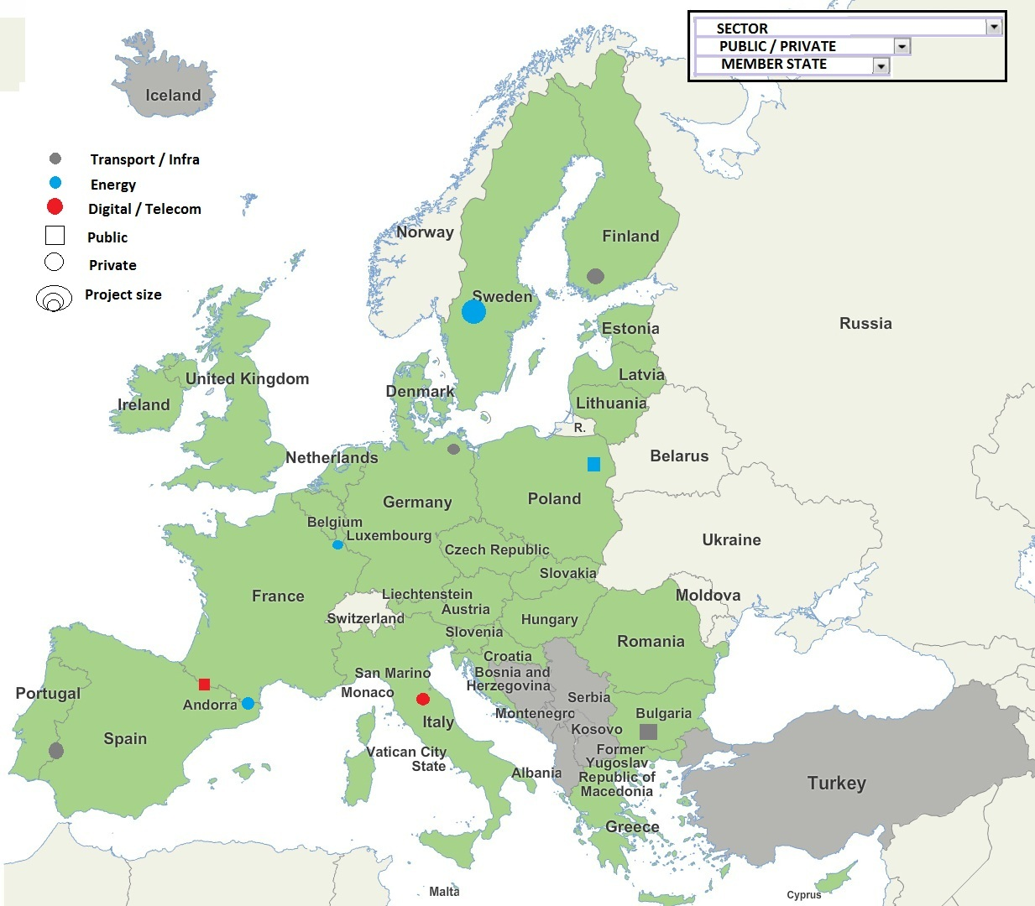
European Investment Project Portal
Prototype

Slide 35
Thank you for your attention – more information available at:
http://ec.europa.eu/priorities/jobs-growth-investment/plan/index_en.htm
http://www.eib.org/about/invest-eu/index.htm
#investEU
#EFSI

Slide 36
Back-up slides

Slide 37
Example of EFSI project/1
Innovative renewable energy infrastructure fund in Denmark
EIB, backed by EFSI, provides equity-type financing of up to EUR 75m to Copenhagen Infrastructure Partners for an innovative infrastructure fund investing in large energy-related projects such as offshore wind, biomass and transmission schemes.
EIB's equity participation would contribute to the fund’s overall market credibility with institutional investors and help broaden its investor base to an international one.
The anticipated high share of offshore wind, biomass and transmission investments is expected to generate considerable employment in the construction phase (2500 - 4000 jobs). It is also estimated that some 1000 jobs may be created during the project’s operation, a significant number of which will be highly-skilled jobs.

Slide 38
Example of EFSI project/2
Energy efficiency in residential buildings in France
The EIB, backed by EFSI, provides a €400m loan to a pioneering financing programme aimed at addressing the need to trigger energy efficiency investments in private homes in France on a large scale.
The project supports an innovative approach by French regions to set up specialised companies to provide a ‘packaged’ solution covering technical and financial assistance to homeowners for retrofitting.
The project is expected to support retrofitting of some 40 000 flats and houses.
Energy efficiency investments will benefit the economy by cutting energy bills, saving emissions and creating new construction jobs (c. 6 000). Total energy savings are estimated to be of the order of 288 000MWh per year. This is roughly equivalent to the annual energy consumption of 9 600 French households.

