Slide 1
InvestEU interim evaluation
Presentation to ELTI members

Slide 2
Invest EU interim evaluation
InvestEU regulation – article 29 (2) : the EC shall submit to the EP, the Council, the EESC and the Committee of the Regions, an independent interim evaluation report on the InvestEU Programme by 30 September 2024
Scope of the interim report: the InvestEU programme, in particular:
- the use and allocation of the EU guarantee
- the inclusion of the Ips and advisory partners
- the partnership between EIB Group and the EC
- the implementation of the InvestEU Advisory Hub and of the InvestEU portal.
An external consultant contracted by the EC will conduct an independent evaluation that will inform the Staff Working Document prepared by the Commission services.
To guide both the external evaluation and the Commission’s report, an Inter-service Steering Group (ISG) is being set up.

Slide 3
Inter-service steering group
The Inter-service Steering Group (ISG) is composed of representatives of Commission services responsible for the four InvestEU policy windows. It is chaired by P. Asdurbali (Ecfin L4).
Representatives from the EIB and EIF, one international financial institution (CoE Bank) and one national promotional institution (CDC, based on ELTI proposal) are invited as observers. => Objective: broadening the ISG’s expertise with the IPs perspective on the InvestEU programme.
During the Summer, ICF (https://www.icf.com/) selected as external consultant
11th October: kick-off meeting

Slide 4
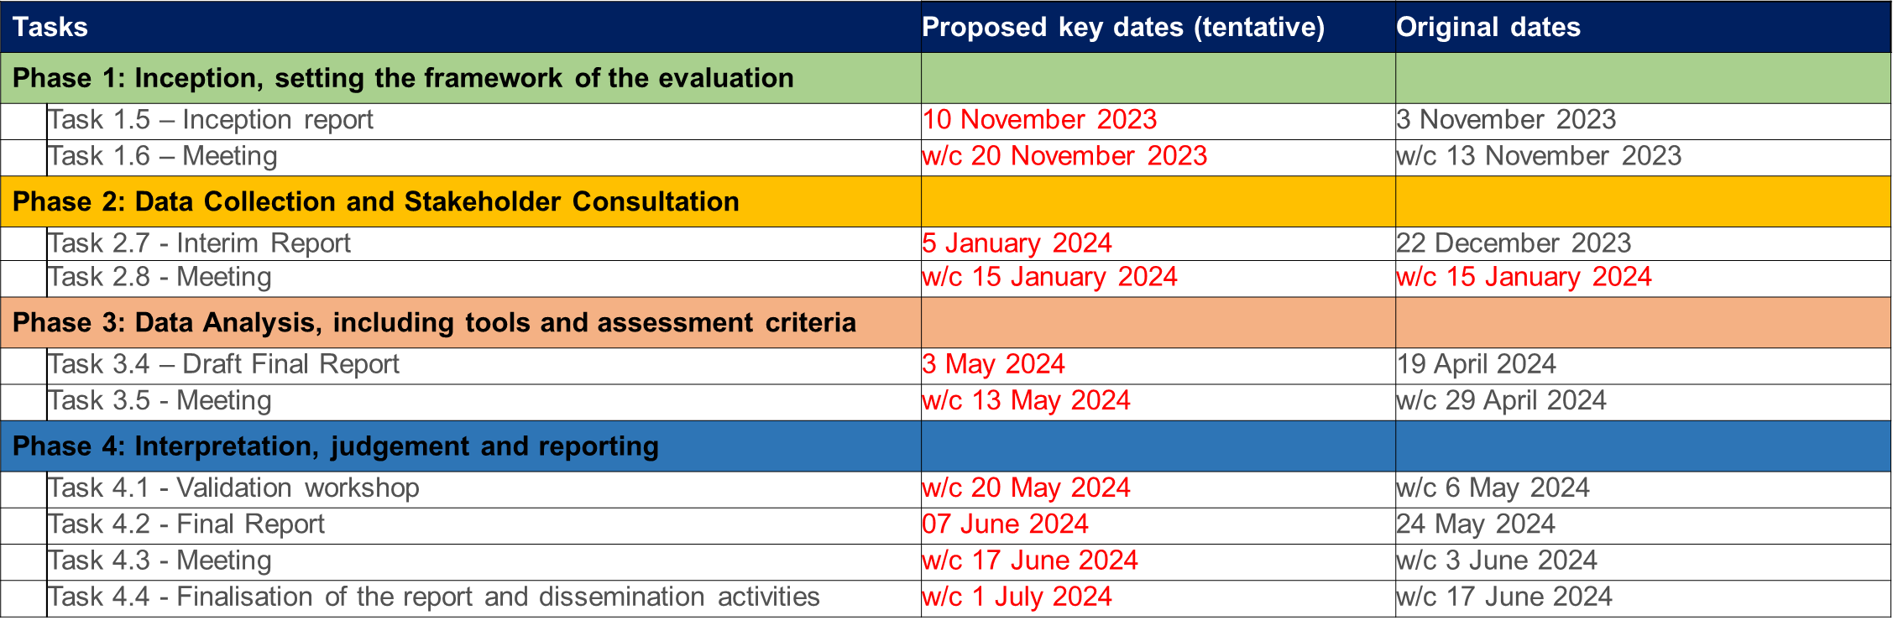
Key milestones
Source: ICF presentation, Kick-off meeting

Slide 5
Implementing partners involvement
SCOPING PHASE
Participation in interviews (observers in ISG)
Access to documentation and data- see next slide
DATA COLLECTION PHASE
Participation in interviews
Assistance with implementation of surveys – promoting surveys to project promoters/ beneficiaries
Access to documentation for projects selected for deep dives
Facilitation of follow-up interviews with counterparts
Data for analysis of costs
DATA ANALYSIS
7 In-depth case studies
INTERPRETATION, JUDGEMENT & REPORTING
Participation in validation workshop
ONGOING
Feedback on deliverables
Source: ICF presentation, Kick-off meeting

Slide 6
Next steps
ASSEMBLE PORTFOLIO
COMPILE
DOCUMENTS
SET-UP SCOPING
INTERVIEWS
Access to non-public documents such as:
Product catalogues
Operational reports from IPs, advisory partners
Risk reports
Presentations to Steering Board
Reports prepared by Advisory Board
Orientations provided to Investment Committee
Ongoing evaluation of predecessor instruments
Portal activities, surveys and reports
Hub activity reports and surveys
InvestEU project portfolio (including list of rejected transactions)
List of Advisory Hub engagements
List of projects and investors registered on the Portal
Relevant contacts for scoping interviews
Commission services
EIB
EIF
Other IPs/ advisory partners
Source: ICF presentation, Kick-off meeting

Slide 7
Involvement through CDC participation in the ISG as observer
U
CDC will share information with ELTI members as much as possible and ask for feedback at the different stages of the evaluation process. Happy to do so in cooperation with ECB.
Already done after the kick-off meeting => the comments received were sent to the ISG secretariat
Before next Thursday, CDC has to vote on the possible themes for in-depth analysis that ICF will conduct.
Scoping interview: all inputs and comments are welcome (no deadline but short term…)

Slide 8
Involvement through CDC participation in the ISG as observer – scoping interview
Making the evaluation relevant and useful – issues requiring deeper exploration and key focus areas for the evaluation
Alignment between their organisation's goals and the Invest EU objectives
Experience with the application and pillar assessment process
Current state of activities being implemented by the partners
Challenges faced during the programme's delayed start and start-up phase
Reflections on the design and governance of the programme – whether programme complexity (4 policy windows, different Investment Committee configurations, thematic versus general products, sustainability proofing requirements etc.) is hampering programme delivery
Feedback on specific design aspects e.g. risk sharing arrangements
Challenges in meeting different requirements of the programme: climate objective, NGEU deadlines , sustainability proofing, reporting requirements etc.
Suggestions for optimizing programme design and delivery based on their experience
Access to data on costs associated with implementing the programme

Slide 9
caissedesdepots.fr

