Slide 1
EU sustainable finance Taxonomy
Exchange of views between NPBS and EIF
07/07/2020

Slide 2
EU Taxonomy Overview
Taxonomy is:
Taxonomy is NOT:
A classification system to establish common language on environmentally sustainable economic activities
It’s not a mandatory list to invest in
Tool to help investors and companies to make informed investment decisions
It’s not a rating of the “greenness” of companies
Facilitating transition of polluting sectors
It does not make any judgement on the financial performance of an investment
Technology neutral
What’s not green is not necessarily brown.
(Activities that are not on the list, are neutral and not necessarily polluting activities. The focus is on activities that contribute substantially to environmental objectives.)
A tool reflecting technological and policy developments: will be updated regularly
Fostering Transparency (disclosures for financial market participants and larger companies)
Notes:
Taxonomy as a ruler for measuring and comparing environmental performance of activities.

Slide 3
Taxonomy Regulation – 6 environmental objectives
Delegated Acts by end of 2020, entry into force June 2021
Climate change mitigation
Climate change adaptation
Delegated Acts by end of 2021, entry into force June 2022
sustainable and protection of water and marine resources;
transition to a circular economy
pollution prevention and control;
protection and restoration of biodiversity and ecosystems.

Slide 4
Taxonomy Regulation – criteria
(c) Comply with minimum social
safeguards
Substantially contribute
to at least one of the six environmental objectives as defined in the Taxonomy Regulation
(b) Do no significant harm to any of the other five environmental objecties as defined in the Taxonomy Regulation
(d) Comply with quantitative or qualitative
Technical Screening Criteria

Slide 5
Taxonomy criteria
Reflecting the level of ambition for economic activities:
GREEN projects:
Make a positive contribution
Avoid significant harm
Social safeguards
Substantial contribution
to at least one of the six environmental objectives
(b) Do no significant harm to any of the other five environmental objecties
(c) Comply with minimum
safeguards
Purely illustrative example

Slide 6
Taxonomy Regulation – 2 objectives covered by the first Delegated Act
Climate change mitigation
Climate change adaptation
Net zero by 2050
50% to 55% reductions by 2030
Prevent/minimise damage
Build adaptive capacity
Increase resilience, future-proof assets, operations, systems or infrastructure adaptation

Slide 7
Taxonomy Regulation – enabling activities
Art.16: “An economic activity shall be considered to contribute substantially
to one or more of the environmental objectives set out in Article 9
by directly enabling other activities to make a substantial contribution
to one or more of those objectives,
and where that activity:
(a) does not lead to a lock-in in assets that undermine long-term
environmental goals, considering the economic lifetime of those assets;
(b) has a substantial positive environmental impact on the basis of
lifecycle considerations.
Examples: Manufacture, sale and installation of highly efficient boilers and micro-renewables.
Objectives 1-6
Safeguards

Slide 8
Taxonomy Regulation - transitional activities
Art.10.2: “An economic activity for which there is
no technologically and economically feasible low carbon alternative
shall be considered to contribute substantially to climate change mitigation […]
where that activity:
(i) has greenhouse gas emission levels that correspond to the best
performance in the sector or industry;
(ii) does not hamper the development and deployment of low-carbon
alternatives; and
(iii) does not lead to a lock-in in carbon-intensive assets considering the
economic lifetime of those assets.
Examples: Cars emitting <50g CO₂/km; manufacturing of cement (emissions lower than 0.498 tCO2e per tonne of cement). Thresholds will be tightened over time.
Objective 1 only
Safeguards

Slide 9
Illustration low-carbon vs transitional activities
Low-carbon activity
e.g. electricity production from wind power
Transitional activity
e.g. cement manufacturing
Electricity production from wind power
High performance
(zero GHG emissions)
Best in class cement manufacturing
Substantial contribution threshold
Substantial contribution threshold
Neutral
space
Neutral
space
DNSH threshold
DNSH threshold
Cement manufacturing with high GHG emissions
Electricity production from coal combustion
Poor performance (high GHG emissions)

Slide 10
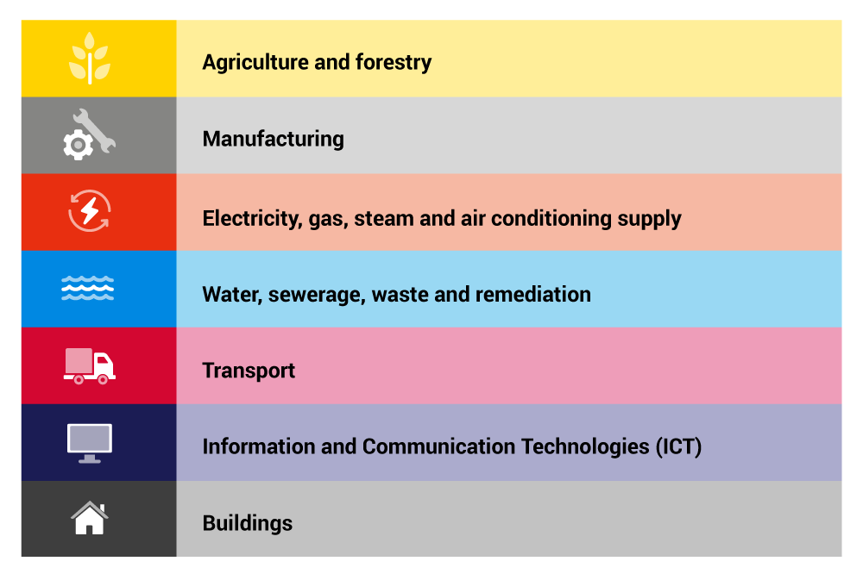
The TEG final report on taxonomy – March 2020
TEG
Composed of 35 experts from civil society, academia, business and the finance sector, as well as 10 additional members and observers from EU and international public bodies
All assessments made by TEG were based on scientific evidence, literature and international practice
TEG report deals with activities substantially contributing to climate change mitigation and adaptation
7 macro-sectors,
70 activities
highest-emitting macro sectors (represent 93.2% of GHG emissions in the EU)
Screening criteria
Substantial contribution to one environmental objective (for climate change mitigation → e.g. GHG emission thresholds)
Do no significant harm to any of the other environmental objectives

Slide 11
What activities has the TEG proposed for inclusion?
Mitigation
Adaptation
8
8
9
9
25
25
12
12
10
10
2
-
4
2
Insurance services
-
1
Engineering services
-
1

Slide 12
Taxonomy design - selection of sectors and setting substantial contribution threshold (climate mitigation)
Sub-sector #1
(e.g. iron & steel production)
Sub-sector #67
(e.g. production of electricity from hydropower)
70 priority ‘economic activities’, i.e. sub-sectors
SC
SC
The universe of
‘economic activities’, classified into 1000+ sub-sectors
Selection/ Prioritisation*
Likely a priority but not yet assessed…
Lower footprint sub-sectors…
…not prioritised for inclusion in the taxonomy
Sub-sectors that were looked at but not included
- No foreseeable technology that will allow the activities within the sub-sector to achieve low/zero GHG emissions or
- Insurmountable DNSH issue
* Prioritisation on the basis of GHG emissions of (sub-) sectors, reduction potential, and/or enabling reductions

Slide 13
Taxonomy and SMEs – relevance
Many SMEs in certain sectors:
Agriculture
Construction
Transport
Suppliers of sustainable projects
+ other 4 env objectives to come!
SMEs is any sector can benefit:
Sustainable transport
Energy efficiency of newly built- or renovation of existing buildings
Energy efficiency of some machinery
+ other 4 env objectives to come!

Slide 14
Practical use of Taxonomy
Taxonomy Regulation
Legal obligation on companies under NFRD scope to disclose alignment
Legal obligation on financial market participants to disclose alignment of financial products
No verification framework – review clause
Using Taxonomy voluntarily or in other legal instruments
No legal obligations for voluntary use
Other legal instruments may define their own conditions for use
…and their own verification frameworks

Slide 15
Taxonomy Regulation disclosure obligations
Three types of investment products under the sustainability disclosure regulation:
TR: “how and to what extent” the underlying investments support Taxonomy-compliant activities
+ DNSH (variable scope)
Art.9 products (“pursuing environmental objectives”)
Art.8 products (“pursuing environmental / social characteristics”)
Mainstream products (i.e. those not pursuing environmental objectives or characteristics)
Statement: “The investments underlying this financial product do not take into account the EU criteria for environmentally sustainable investments”.
Disclosure by companies covered by the NFRD (review foreseen)
Taxonomy-alignment of activities
Proportion of turnover
Proportion of CapEx and OpEx

Slide 16
Disclosures obligations by companies and financial market participants
Adoption DA: Specifying disclosure obligations for financial and non-financial companies
Disclosures for activities related to cc mitigation and adaptation (covering the financial year 2021, publication in the course of 2022)
Disclosures for activities related to all environmental objectives (covering the financial year 2022,) publication in the course of 2023
Companies
under Art. 19a or 29a of the NFRD
End 2020
Mid 2021
End 2021
End 2022
Adoption DA: Technical screening criteria for cc mitigation and cc adaptation
Adoption DA: Technical screening criteria for the other environmental objectives
Disclosures in relation to cc mitigation and adaptation in periodic reports, pre-contractual disclosures and on websites
Disclosures in relation to all environmental objectives in periodic reports, pre-contractual disclosures and on websites
Financial
market
Participants

Slide 17
Further possible uses of Taxonomy
Standards and Labels
EU GBS
EU Ecolabel for financial products
InvestEU
Climate and environmental tracking
Sustainability proofing
Public uses beyond InvestEU (SEIP commitment to explore public use of Taxonomy)
Green Budgeting ?
State Aid ?
Public Procurement ?
EU Structural and Cohesion Funds ?

Slide 18
Use of the taxonomy by companies– steps to calculate Taxonomy alignment
1 | Identify activities for which Technical Screening Criteria have been identified.
2 | For each activity, collect the environmental information and assess whether the activity meets the relevant criteria for substantial contribution e.g. electricity generation <100g CO₂/kWh.
3 | For each activity, collect the environmental information and assess whether the activity meets the relevant criteria for ‘Do no significant harm’.
4 | Make sure the activity complies with the minimum safeguards.
5 | Break down and calculate the portion of Turnover that is taxonomy aligned and the portion of CapEx& OpEx that is taxonomy aligned.

Slide 19
Use of the taxonomy by investors – five steps to calculate Taxonomy exposure (based on TEG recommendations)
1 | Identify the activities conducted by the company or issuer that could be aligned, and for which environmental objective(s).
2 | For each activity, check based on the company information whether the activity meets the relevant criteria for substantial contribution e.g. electricity generation <100g CO₂/kWh.
3 | Assess based on the company information that the DNSH criteria are being met. Investors could use a due diligence-type process for reviewing the performance of investees and could rely on the legal disclosures by those investees.
4 | Conduct due diligence to avoid any violation to the minimum safeguards (Art.13 Taxonomy Regulation).
5 | Calculate alignment of investments with the Taxonomy and prepare disclosures at the investment product level.

Slide 20
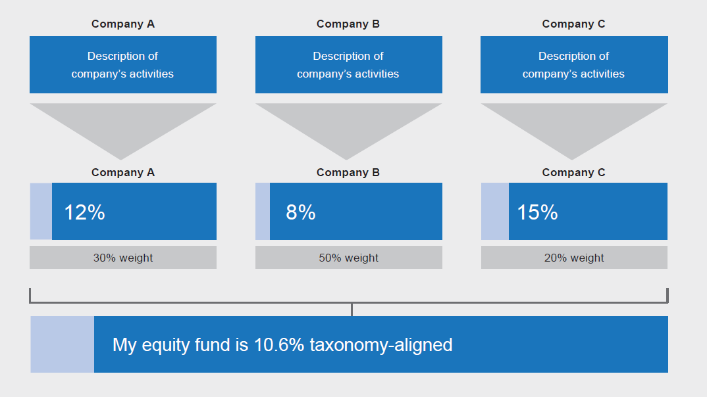
Measuring Use of the taxonomy by investors : Equity

Slide 21
Transition tool - how does it help companies to transition?
By defining green economic activities, not companies
The Taxonomy enables companies to transition by gradually increasing their share of green activities
Legend
= Site/project/operation that is Taxonomy-aligned
= Site/project/operation that is not Taxonomy-aligned
Company Z
Share of green activities
2020
A
B
C
D
20%
Factory A expands
Factory B increases energy efficiency
2025
A
B
C
D
50%
Factory C is closed
Factory E is built
2030
A
B
E
D
70%

Slide 22
Thank you for your attention

